Slide 1
Choosing Between Models

Slide 2
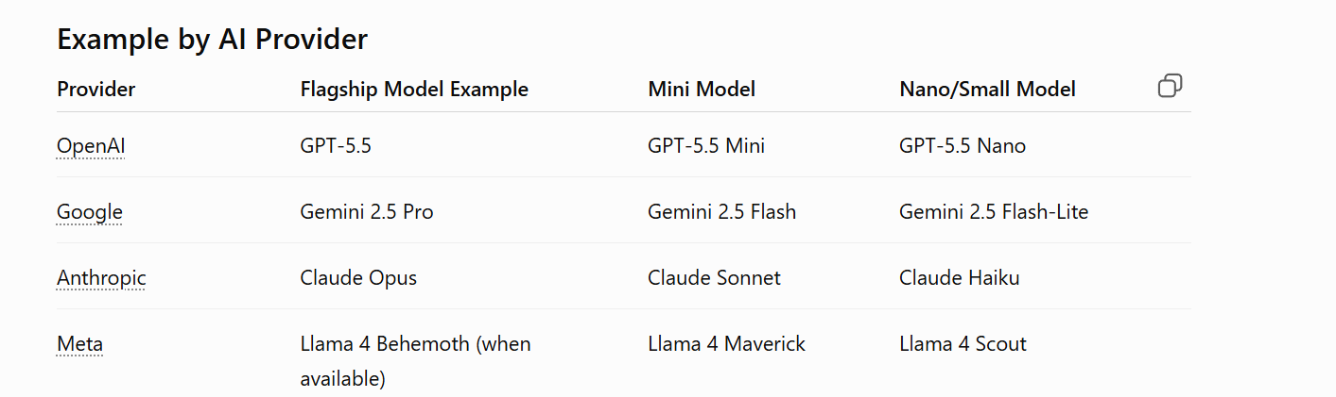
Popular LLM Providers and models

Slide 3
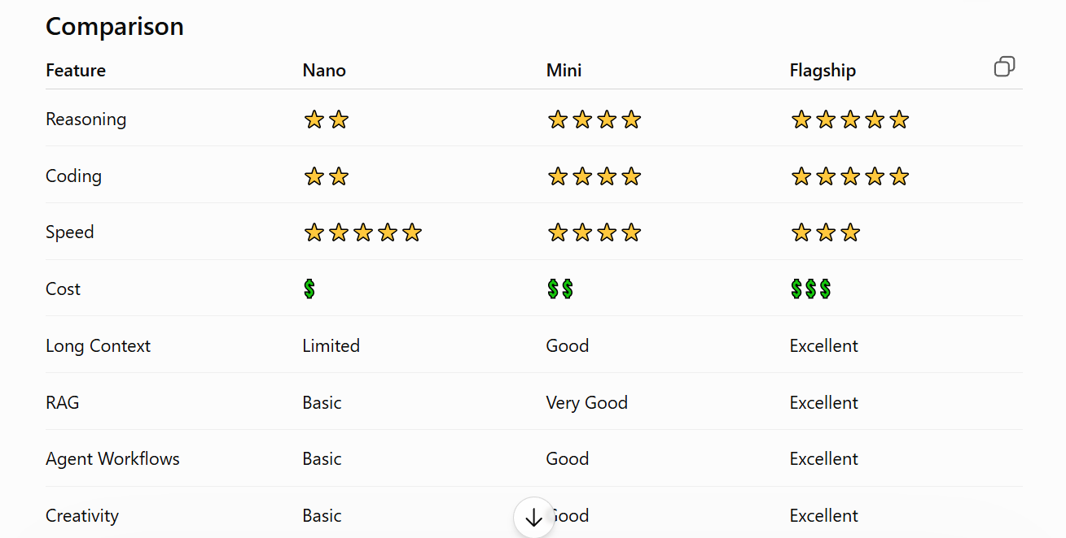
Model Comparision

Slide 4
Flagship/Reasoning Models model
Accuracy matters more than cost. (Tax sheet)
The task involves complex reasoning.
You're building coding assistants.
You're working in regulated domains such as finance or healthcare.
You need sophisticated AI agents.
You want the highest-quality output.

Slide 5
Mini model
You need a balance of quality, speed, and cost.
You're building chatbots or internal assistants.
Most requests are of moderate complexity.

Slide 6
Nano model
The task is simple (classification, routing, tagging).
Low latency and low cost are the highest priorities.
You're handling very high request volumes.

Slide 7
Reasoning Models
Reasoning Models
Below are few reasoning models
GPT‑4 (full versions)
Claude 3 Sonnet
Gemini Advanced / Ultra
LLaMA‑3‑70B

Slide 8
Simple Model - Problems
Below are few simple models
GPT‑3.5‑Turbo
LLaMA 2 7B
Phi‑2
GPT‑4‑Lite style models
These are Optimizes for fast responses
Not able to Plan based on Task.
Fails where multi-step decision making required.

Slide 9
Problems with Simple Models
User Ask
“Can you write and drop email me my order details and please share last 5 month orders.
Tasks
Email
Fetch Order details
Fetch last 5 month order
Execution Wrong Order

Slide 10
Problems with Simple Models
User Ask -
“Getting time out Error can you suggest how to fix”
Simple Model will provide reasons like results like
Server is down
“Increase timeout”

Slide 11
Reasoning Models
User Prompt- “Can you drop email me my order details and please share last 5 month orders.
Reasoning Model will work like below
First, it will read complete sentence
Will Create Plan like below
1.Fetch Order details
2. Fetch Last 5 month Order details
3.Combine Both into one.
4. Draft User professional Email
5.Send Email.
Correct Execution

Slide 12
Reasoning Models
“can you check logs and share detailed analysis why error occurred; we got error yesterday at 7 pm”
Now LLM will plan like below
Read complete sentence
Will see what to do — Read operation it is
Will navigate Log files
Search for Log file for date = Today’s Date -1 (yesterday)
Scan File and see date time present on logs and Capture Log.Error around 7 pm
if Found then It will pick error Context
Make Call to Codex/ Claude Model to get detailed analysis and Root causes
Will Drop Email to Admin.

Slide 13
Domain Models
Sometimes we have specific task related to Domain like
Doctors are doing some research based on some diseases then they will input some symptom or pattern of disease to understand disease etc
Hugging face.
genzeonplatform/healthcare-brain-medication-ner · Hugging Face
genzeonplatform/healthcare-brain-clinical-findings-ner · Hugging Face

